Slide 1

Efficient Localization of Multiple Intruders in Shared Spectrum Systems
Caitao Zhan, Himanshu Gupta, Arani Bhattacharya*, Mohammad Ghaderibaneh
Stony Brook University, KTH*

Slide 2
CONTENTS
Introduction
Problem
Solution
Evaluation
Conclusion

Slide 3
1 Introduction
The RF spectrum is a limited natural resource in great demand. US propose the shared spectrum paradigm to increase utilization.
Software-defined radio (SDR) technology gives ordinary people easy access to RF spectrum, both receive and transmit.
Security threat! Selfish users can transmit data on shared spectrum without authorization.
→ Find out the selfish unauthorized users!
Title:
Efficient
Localization
of
Multiple Intruders
in
Shared Spectrum Systems
Notes:
a) due to the increase in mobile (and hence, wireless) data consumption

Slide 4




1 Shared Spectrum
Shared spectrum: primary users and secondary users share the spectrum.
Licensed
Unlicensed
Given permission
Always
Authorized
transmission
Intruder
Interfere
Localize
?
Notes:
Primary users are licensed by the government. Common primary users are federal agencies, telecom operators etc.
Secondary users could be as small as a person, or as large as a company.

Slide 5



2 Problem -- Illustration
Location?
Power?
Secondary (SU)
Primary (PU)
Sensor
Intruder
Location?
Power?
Sensor
Notes:
Let’s illustrate the problem
Any questions for this?
We can observe that MTL is easier than MTL-SS.
We will solve MTL first, and then MTL-SS.

Slide 6
2 Problem Definition & Challenges
Consider a geographic area, assume a single channel.
Distribute a set of crowdsourced sensors. They report RSSI.
Three types of transmitters/users: Primary, secondary, intruders.
Definition. MTL-SS: given the observations from the sensors, localize the intruders and estimate the intruders’ power.
Challenges:
Sensor receives only a sum of the signals from the multiple intruders transmitting simultaneously.
Multiple targets to localize, some might be close to each other.
Dynamically changing authorized users in the background.

Slide 7
2 Talk Focus: Multiple Transmitter Localization
For this talk, we largely assume no background users (primary/secondary user)
Only intruders and sensors → multiple transmitter localization problem
Notes:
Let's look at the challenges

Slide 8
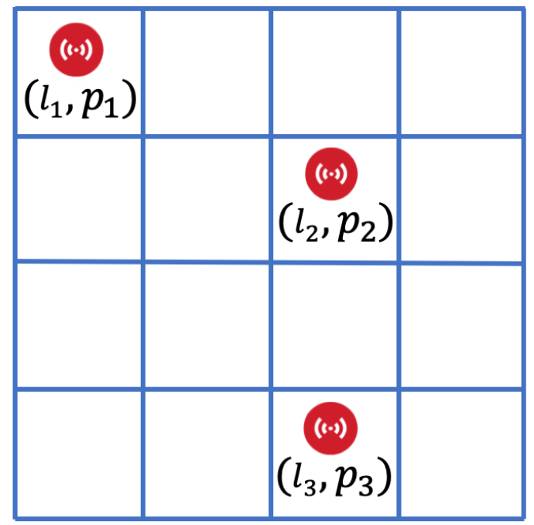

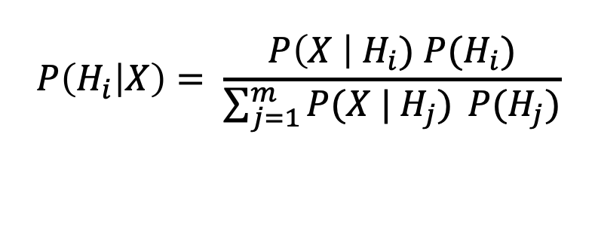
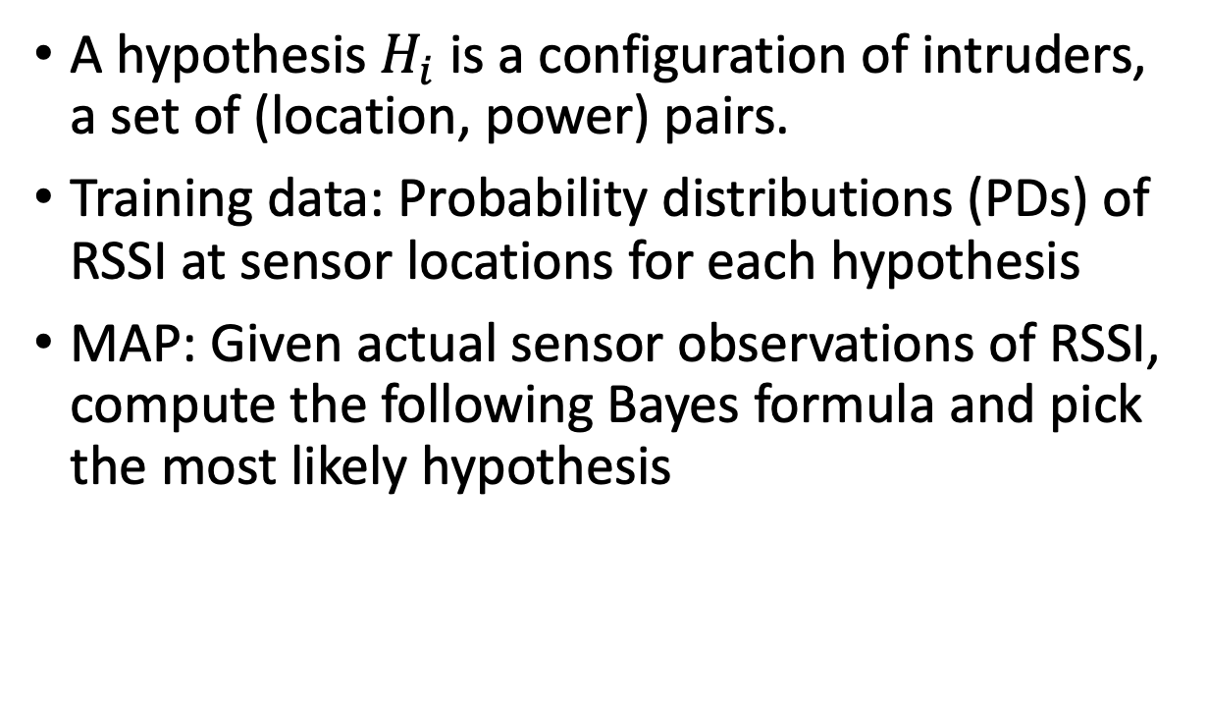
3 High-level Approach: MAP (Maximum a Posterior)
A hypothesis $H_{i}$is a configuration of intruders, a set of (location, power) pairs.
Training data: Probability distributions (PDs) of RSSI at sensor locations for each hypothesis
MAP: Given actual sensor observations of RSSI, compute the following Bayes formula and pick the most likely hypothesis
$$P\left(H_{i} | X\right)= \frac{P\left(X \right|{ H}_{i}) P(H_{i})}{\sum_{j=1}^{m}{P(X | H_{j})} P(H_{j})}$$
A single hypothesis

Slide 9
3 Pros & Cons of MAP
Pros
Optimal classification accuracy
No need to assume a propagation model
Allows to estimate intruders’ power
Extends to solve MTL-SS problem with background users
Cons:
High computation cost
Divide-and-conquer
High training cost
Interpolation
Only train for a single intruder, assuming conditional independence, and utilizing power summations

Slide 10
3 MAP*: Optimizing MAP
Core idea: Divide-and-conquer
Far-away isolated intruders can be localized independently
Close-by intruders in a cluster are localized later
Procedure 1: isolated intruders
Procedure 2: Multiple intruders close-by
Hypothesis represents a single intruder
Run MAP at appropriate local areas
Hypothesis represents two or three intruders
Construct multi-intruder PDs from training data (of single intruders)
Run MAP at appropriate areas
Notes:
value of (power of the sum) of multiple signals equals to (sum of the powers) of those individual signals. linear power here.

Slide 11
3 MAP* Illustration
Procedure 2
Procedure 1
Sensor
Procedure 1
Intruder
Sensor
Notes:
Let’s illustrate the problem
Any questions for this?
We can observe that MTL is easier than MTL-SS.
We will solve MTL first, and then MTL-SS.

Slide 12

3 Reduce Training Cost via Interpolation
Idea: Construct some PDs, estimate others via interpolation
Train at coarse granularity
Interpolate at fine granularity
TX

Slide 13
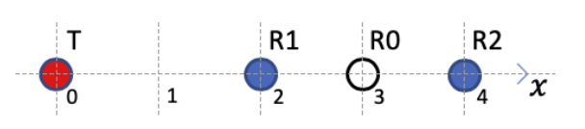
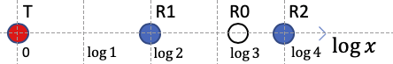
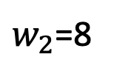
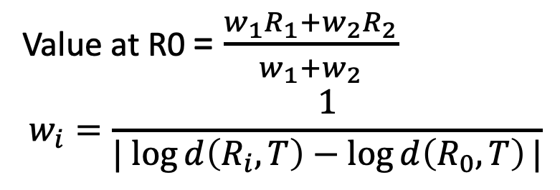
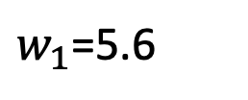
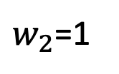
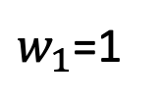
3 Novel Interpolation Technique (ILDW)
Key idea of ILDW (Inverse log-distance weighting)
Take advantage of the know TX location
Modify inverse-distance weighting (IDW): assign weights based on the distance in “logarithm domain”
$w_{1}$=1
$w_{2}$=1
IDW
Value at R0 = $\frac{w_{1}R_{1}+w_{2}R_{2}}{w_{1}+w_{2}}$
$$w_{i}=\frac{1}{| log{d\left(R_{i}, T\right)}−\log{d\left(R_{0}, T\right)}|}$$
ILDW
$w_{1}$=5.6
$w_{2}$=8

Slide 14
3 Extensions: With Background users; Power Estimation
MAP* can be extended to incorporate some changing set of background secondary users via online training
Derive a closed-form formula solution to estimate the power of intruders in the continuous domain using maximum likelihood estimation.

Slide 15
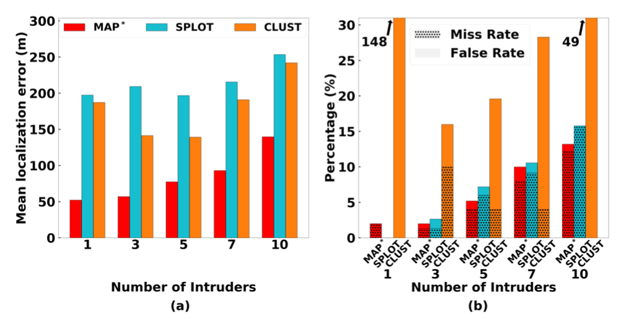
4 Evaluation – MAP*, Simulation
Compare to 1) Clustering-based solution
2) SPLOT (MobiCom 2017, current state-of-the-art)
MAP* has lower localization error
and sum of miss rate and false alarm rate.
Notes:
Localization performance of various algorithms in a large scale simulation, for varying number of intruders

Slide 16
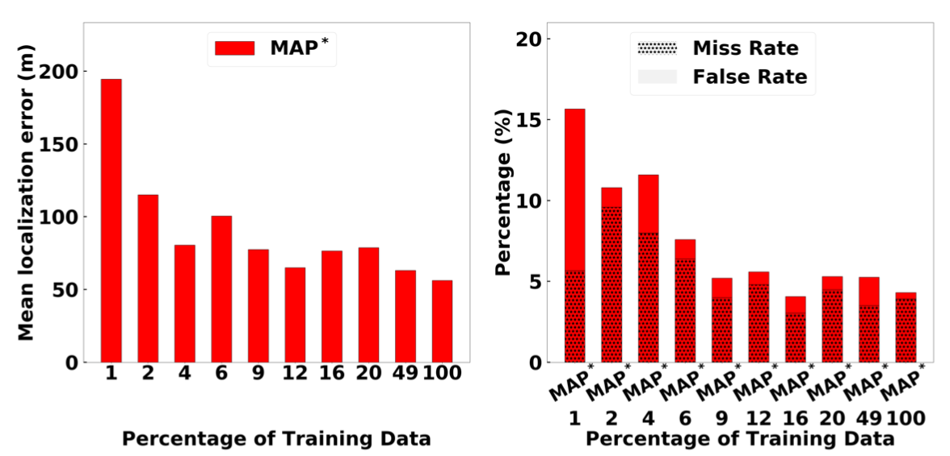
4 Minimizing Training Cost: Simulation
With ~10% of real training data and ~ 90% of interpolated data, MAP* can give a good localization performance
Notes:
Localization performance of MAP∗ in a large scale area, for varying training data

Slide 17
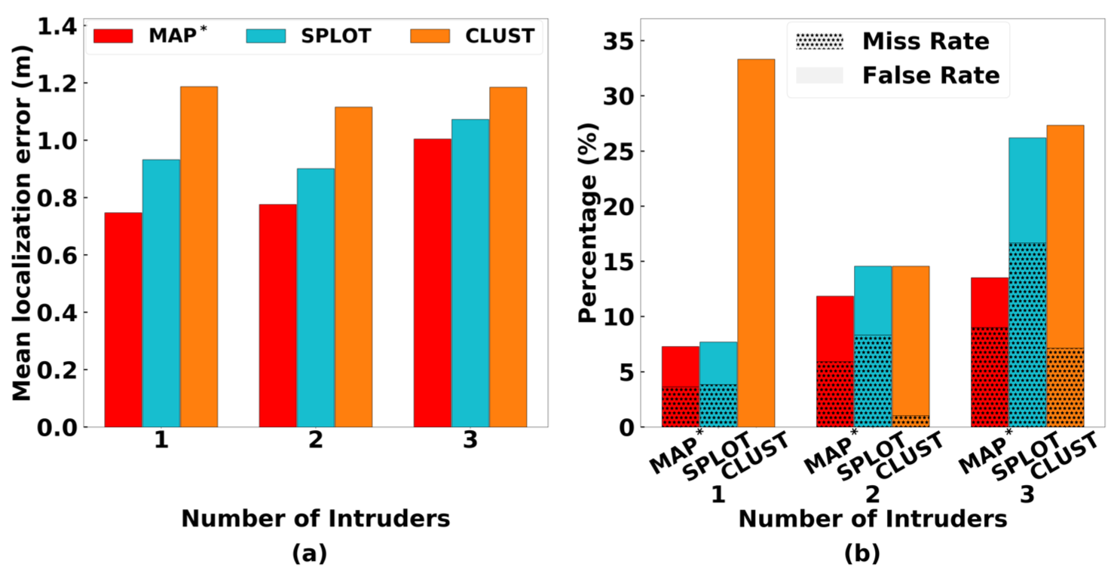
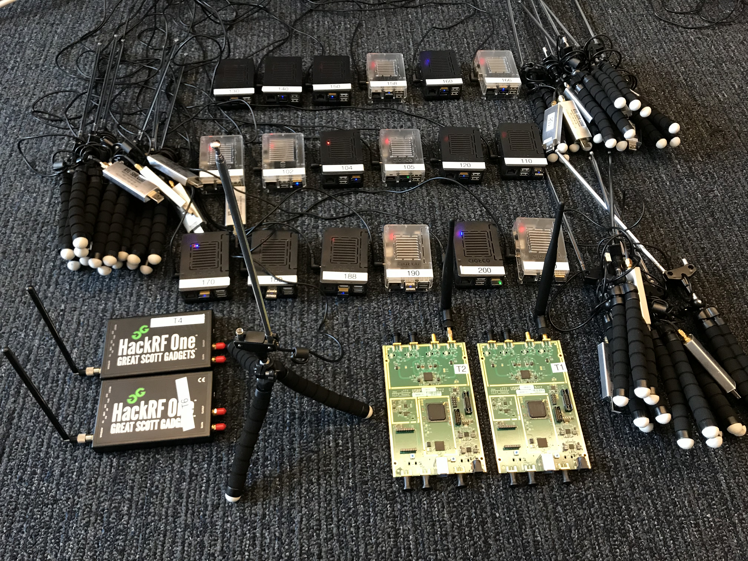
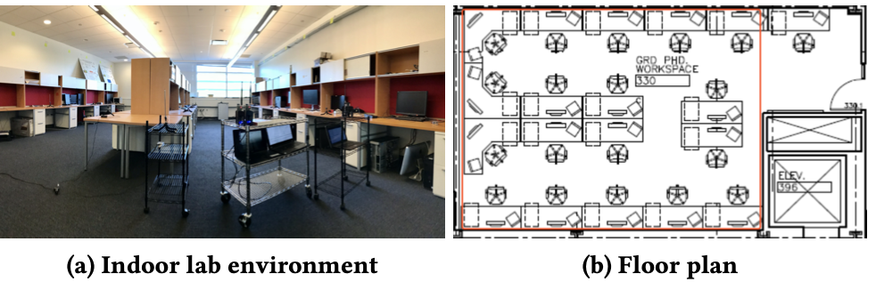
4 MAP*, Indoor Testbed
SDR devices and
single board computers
MAP* has lower localization error
and sum of miss rate and false alarm rate.
Notes:
Localization performance of varies algorithms in an indoor testbed, for varying number of intruders

Slide 18
5 Conclusion
Developed an efficient learning-based method for the multiple intruder localization problem in shared spectrum
Introduce an interpolation method ILDW and power estimation method
Thank You For Listening! Any Questions?
The paper and slides are at: https://caitaozhan.github.io/

Slide 19
Backup Slides

Slide 20
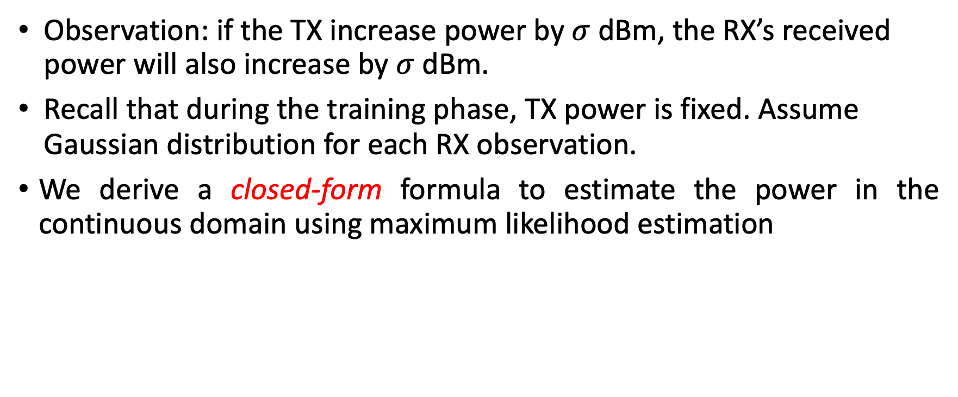
3 Estimate Power in MAP*
Observation: if the TX increase power by $σ$dBm, the RX’s received power will also increase by $σ$dBm.
Recall that during the training phase, TX power is fixed. Assume Gaussian distribution for each RX observation.
We derive a closed-form formula to estimate the power in the continuous domain using maximum likelihood estimation

Slide 21
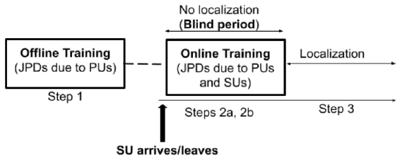
3 MAP** for MTL-SS
Now we include authorized users, i.e. primary and secondary users
Primary Users (PU): assume static, but configurations may be unknown
Secondary Users (SU): assume dynamic, configurations are known.

Slide 22
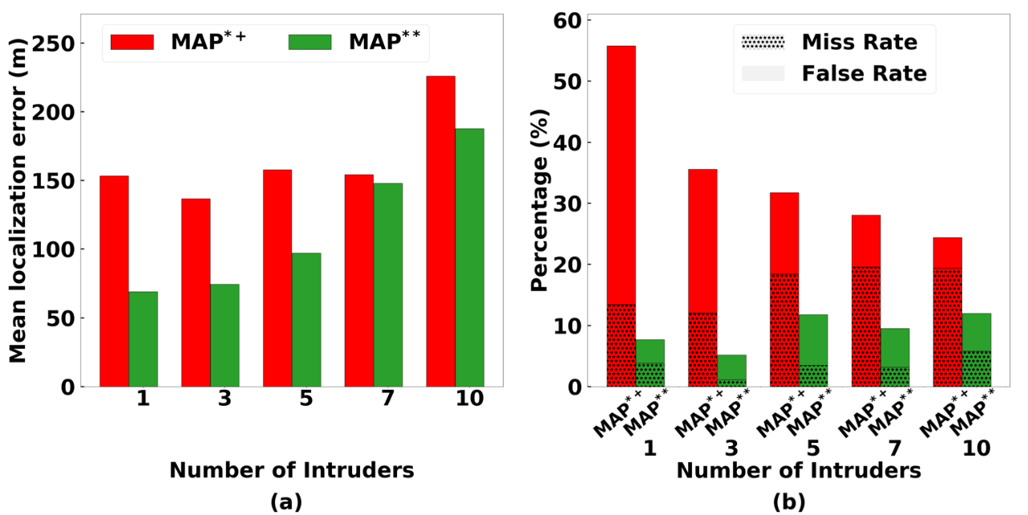
4.3 MAP** for MTL-SS, Large Scale Simulation

Slide 23
3 Solution – Four Building Blocks
ILDW
Spectrum interpolation for training
MAP*
Estimate the location of multiple intruders
MLE
Estimate the power of multiple intruders
MAP**
Estimate the location of multiple intruders with primary and secondary users exists in background
Notes:
Four building blocks – four minutes

Slide 24
3.3 MAP** for MTL-SS
Offline Training
Signal
Distributions
Construct
Signal
Distributions
Interpolation
Online
Training
Sensor
Sensor
Observations
Secondary (SU)
Primary (PU)
Localize
Intruders
Intruder
Notes:
2890-

Slide 25
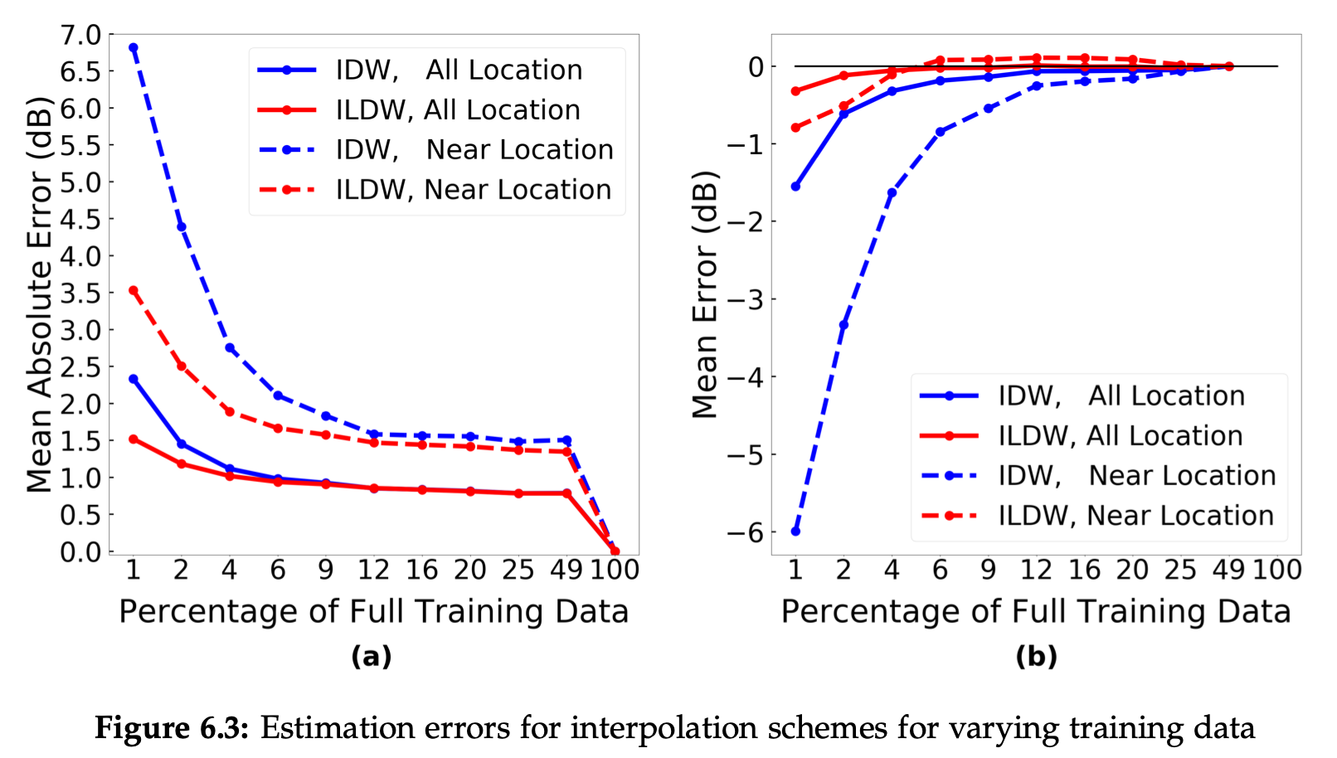
5.3 Simulation: MTL -- Varying Training Data

Slide 26
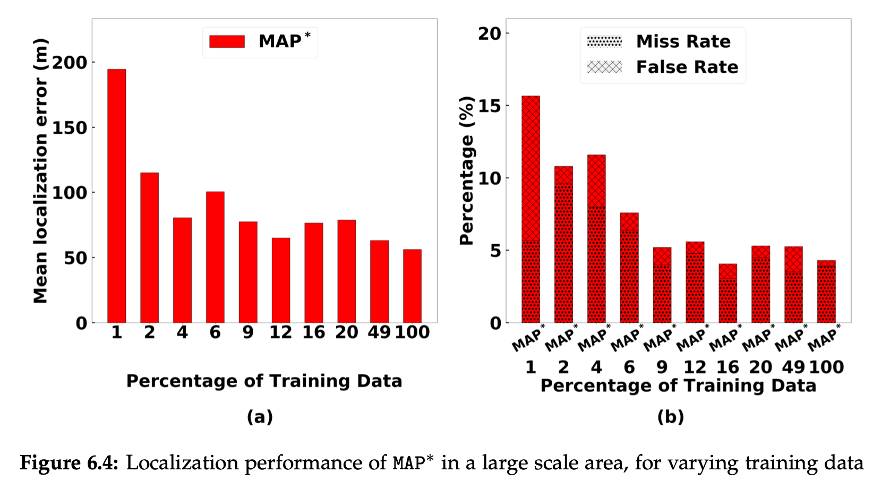
5.3 Simulation: MTL -- Varying Training Data

Slide 27
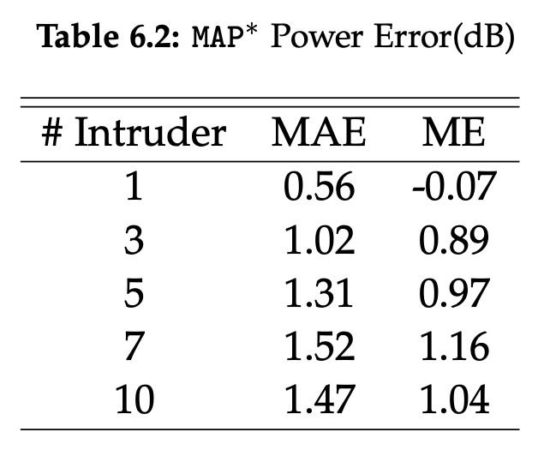
5.3 Simulation: MAP* Power Error

Slide 28
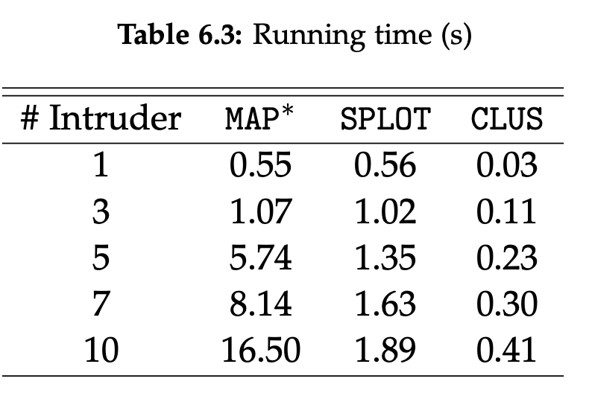
5.3 Simulation: Running Time

Slide 29
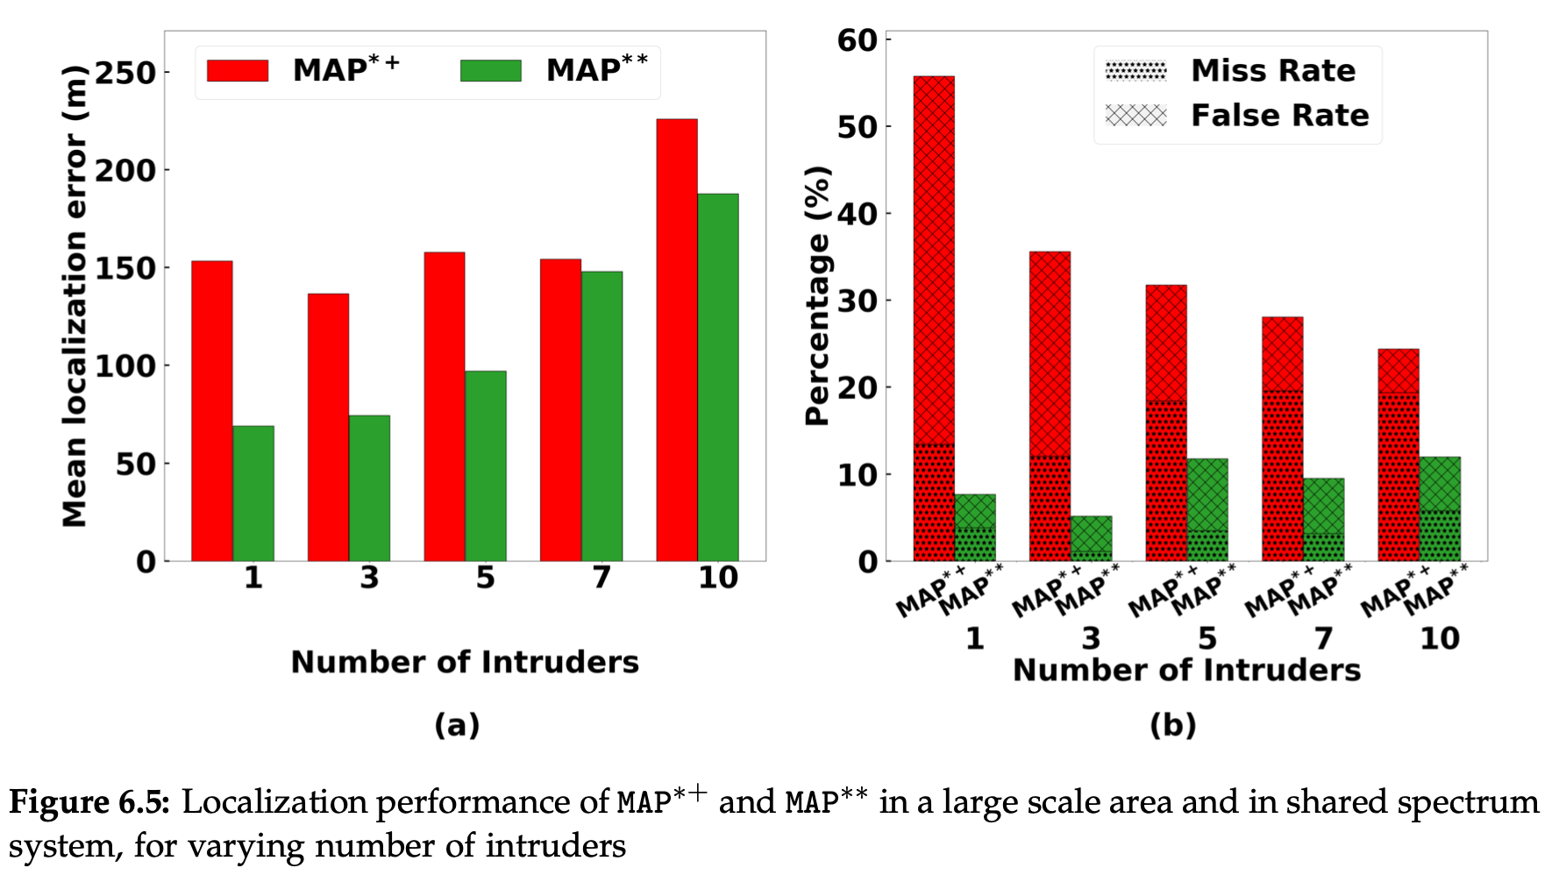
5.3 Simulation: MTL-SS, 2 PU, 3 SU and Varying # of Intruders

Slide 30
5.4 Small Scale Testbed: Devices

Slide 31
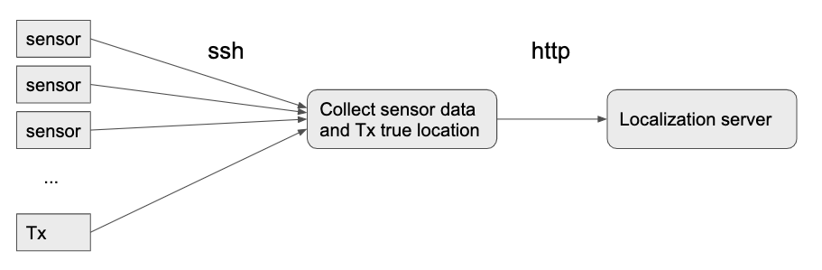
5.4 Small Scale Testbed: Architecture

Slide 32
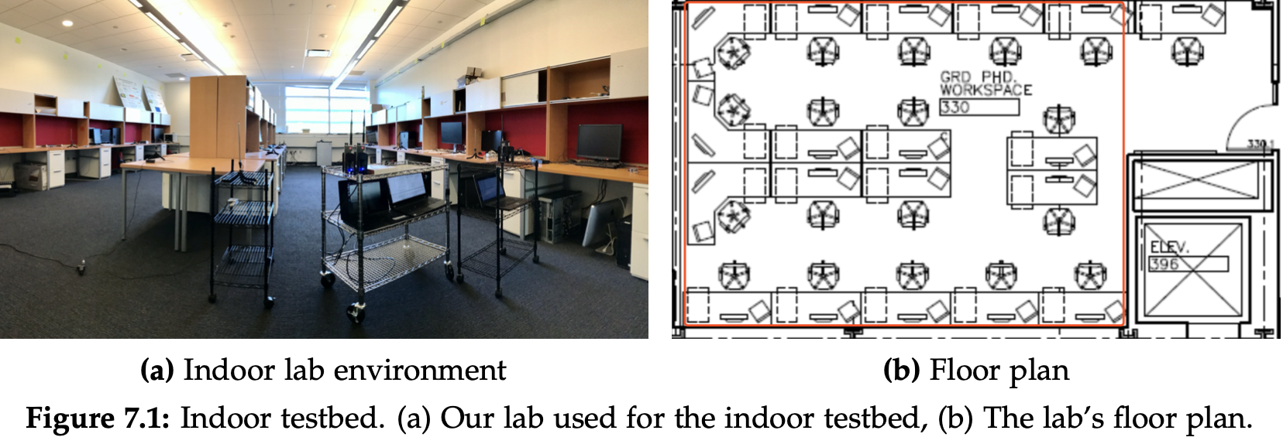
5.4 Small Scale Testbed: Indoors

Slide 33
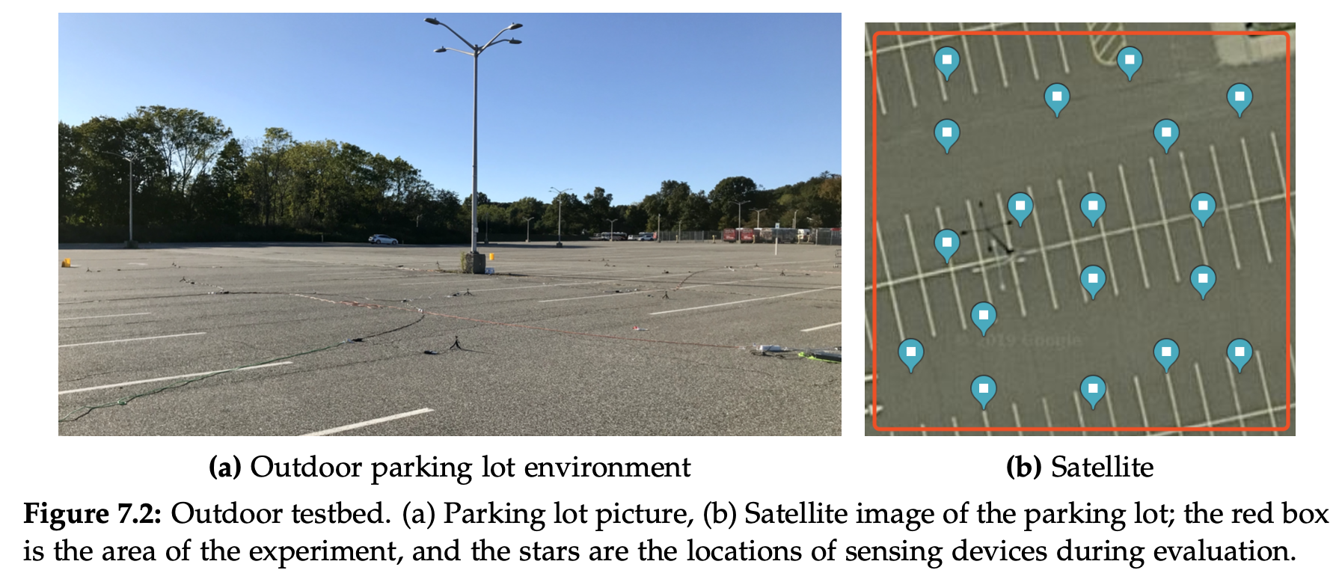
5.4 Small Scale Testbed: Outdoors

Slide 34
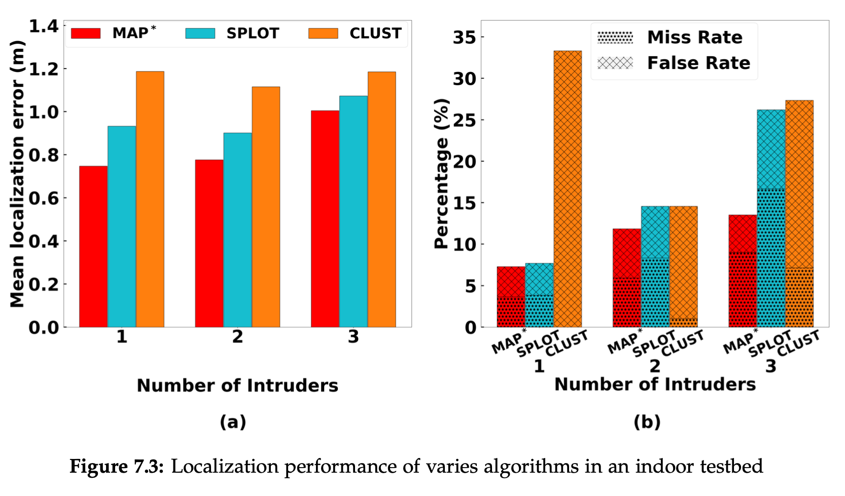
5.4 Small Scale Testbed: (Only Show one Result)

Slide 35
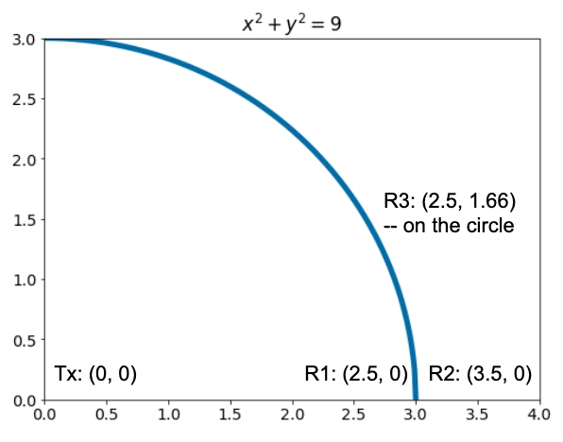
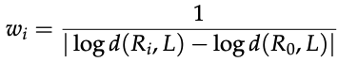
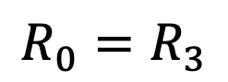

4.4 An Extreme Case
$w_{3}$ will be infinity
$$R_{0}=R_{3}$$
R0
Notes:
Note that if R3 is not in the neighbourhood, then it won’t be included in the calculation.

Slide 36
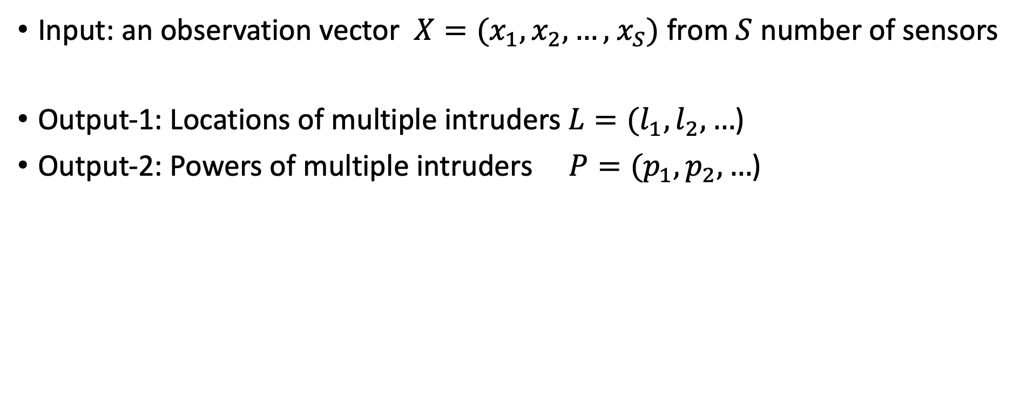
3.3 Problem – Input and Output
Input: an observation vector $X=(x_{1},x_{2},…,$ $x_{S})$ from $S$ number of sensors
Output-1: Locations of multiple intruders $L=(l_{1},l_{2}, …$)
Output-2: Powers of multiple intruders $P=(p_{1},p_{2}, …$)
Notes:
Let’s take a closer look at the input and output…
Now the problem is clear. Any questions?

Slide 37
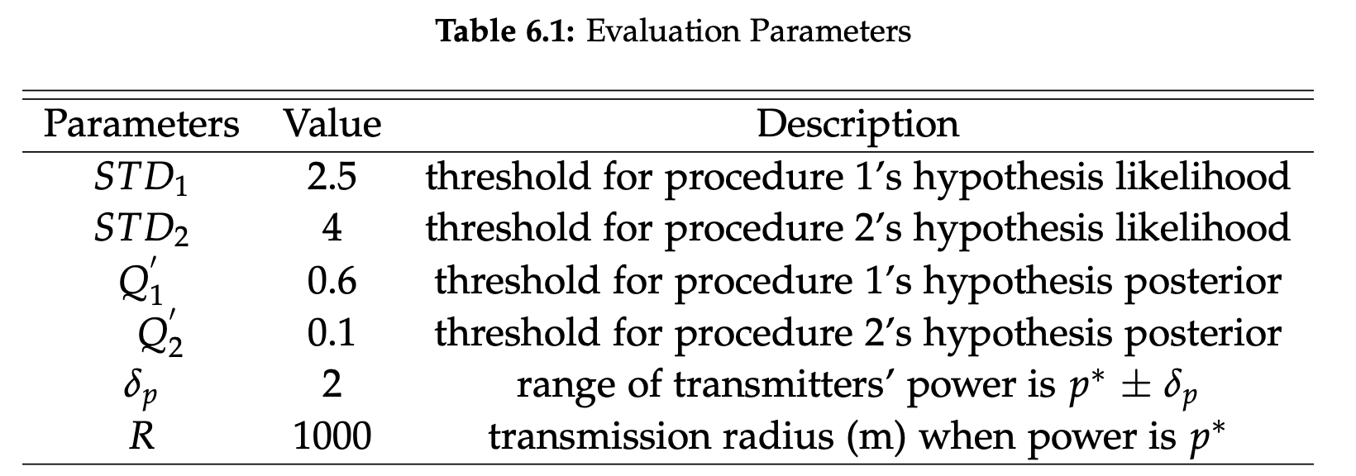
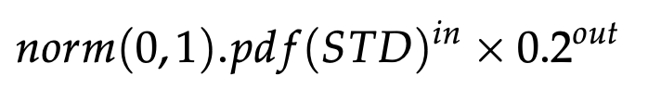
Thresholds

Slide 38
2.5 Related work --- Where do we fall in?
Environment? | Outdoors, indoors, IoT
Localizing Target? | RX, TX, tag-based, device-free
Wireless Technology? | GPS, WiFi, Bluetooth, RFID, UWB, light, acoustic, ultrasonic. LoRa, SigFox. SDR(USRP, RTL-SDR, …)
Wireless Signal Metric? | CSI(AOA, TOA, TDOA, POA), RSSI
Localization Method? | Trilateration (distance measured by CSI, RSSI) Triangulation (angles measured by AOA) Fingerprinting (CSI, RSSI)
Number of Target? | Single, multiple
Notes:
We also do localization, where do we fall in?

Slide 39
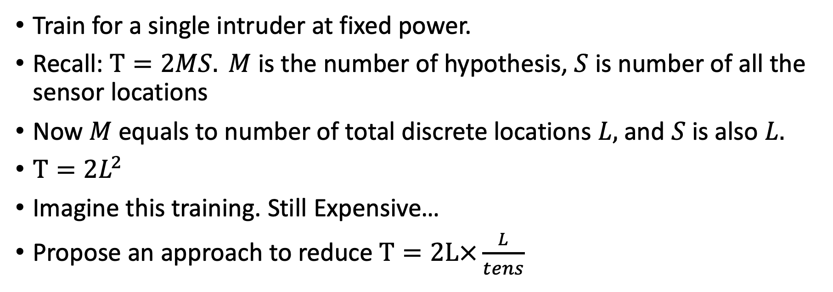
3.1 Reduce Training Cost via Interpolation
Train for a single intruder at fixed power.
Recall: $Τ=2MS. M$ is the number of hypothesis, $S$ is number of all the sensor locations
Now $M$ equals to number of total discrete locations $L,$ and $S$ is also $L.$
$Τ=2L^{2}$
Imagine this training. Still Expensive…
Propose an approach to reduce $Τ=2L×\frac{L}{tens}$

Slide 40
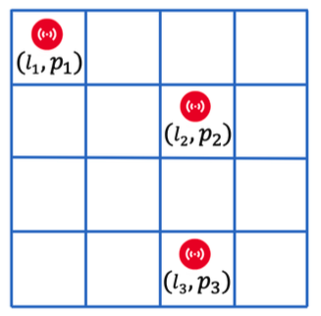

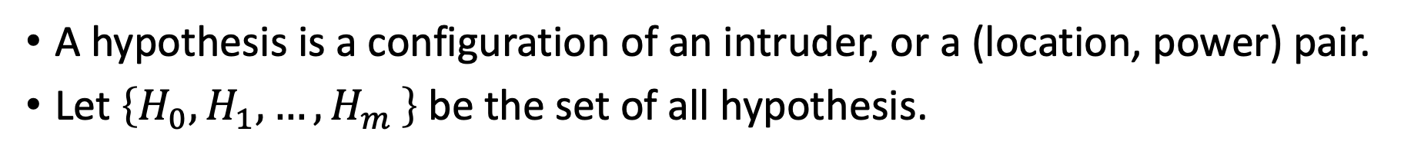
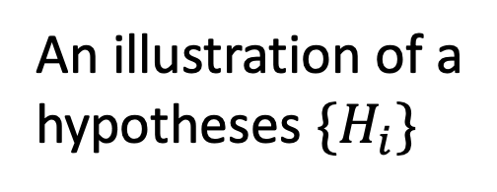
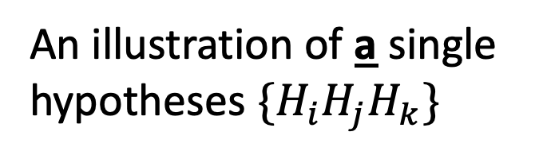
3.2 MAP*: Generalized Maximum a Posterior
A hypothesis is a configuration of an intruder, or a (location, power) pair.
Let $\left\{H_{0},H_{1}, {…,H}_{m}\right\}$be the set of all hypothesis.
An illustration of a
hypotheses ${\{H}_{i}\}$
An illustration of a single
hypotheses $\{H_{i}H_{j}H_{k}\}$

Slide 41
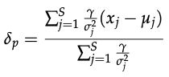

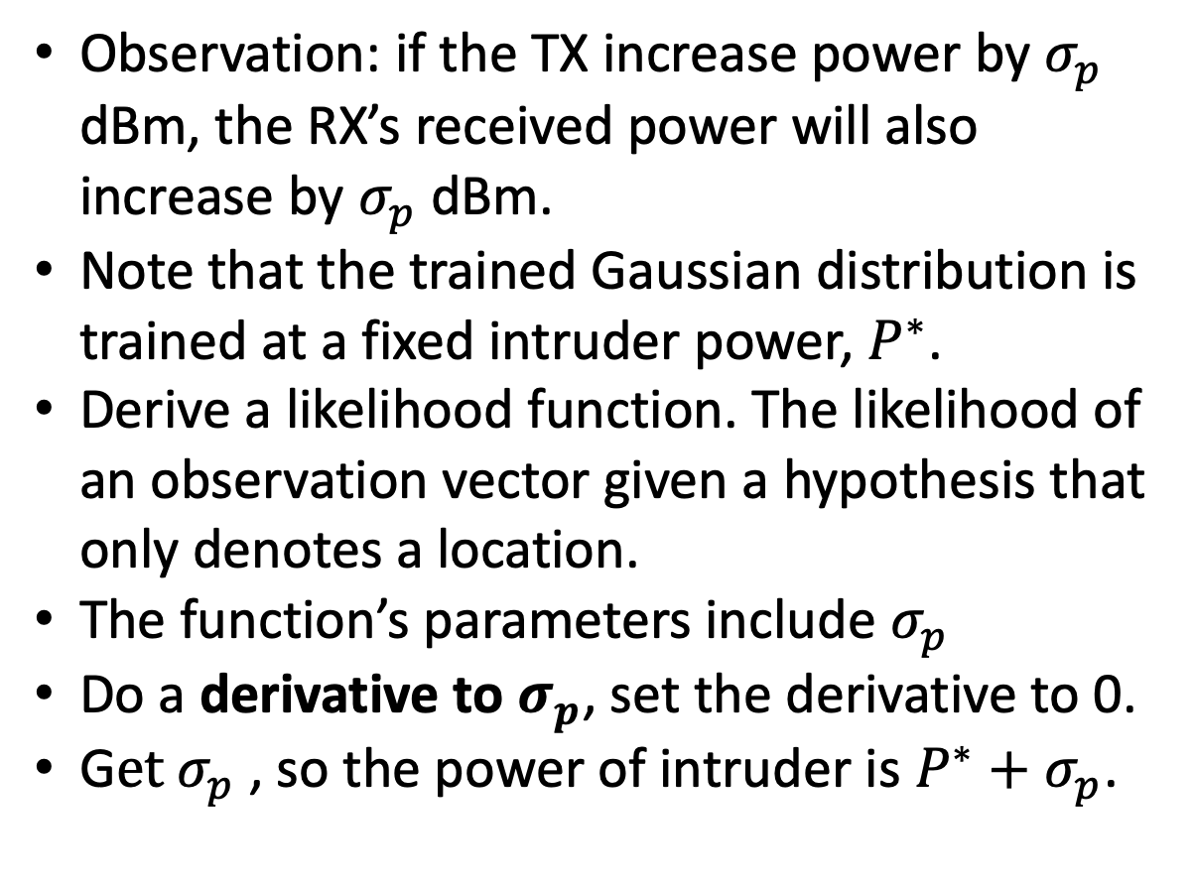


3.3 Optimize Estimation of Power in MAP*
+1
Observation: if the TX increase power by $σ_{p}$ dBm, the RX’s received power will also increase by $σ_{p}$ dBm.
Note that the trained Gaussian distribution is trained at a fixed intruder power, $P^{∗}$.
Derive a likelihood function. The likelihood of an observation vector given a hypothesis that only denotes a location.
The function’s parameters include $σ_{p}$
Do a derivative to $σ_{p}$, set the derivative to 0.
G$et σ_{p}$ , so the power of intruder is $P^{∗}+σ_{p}$.
+1
Sk
Notes:
Complete proof of the lemma is in the appendix of RPE report

Slide 42
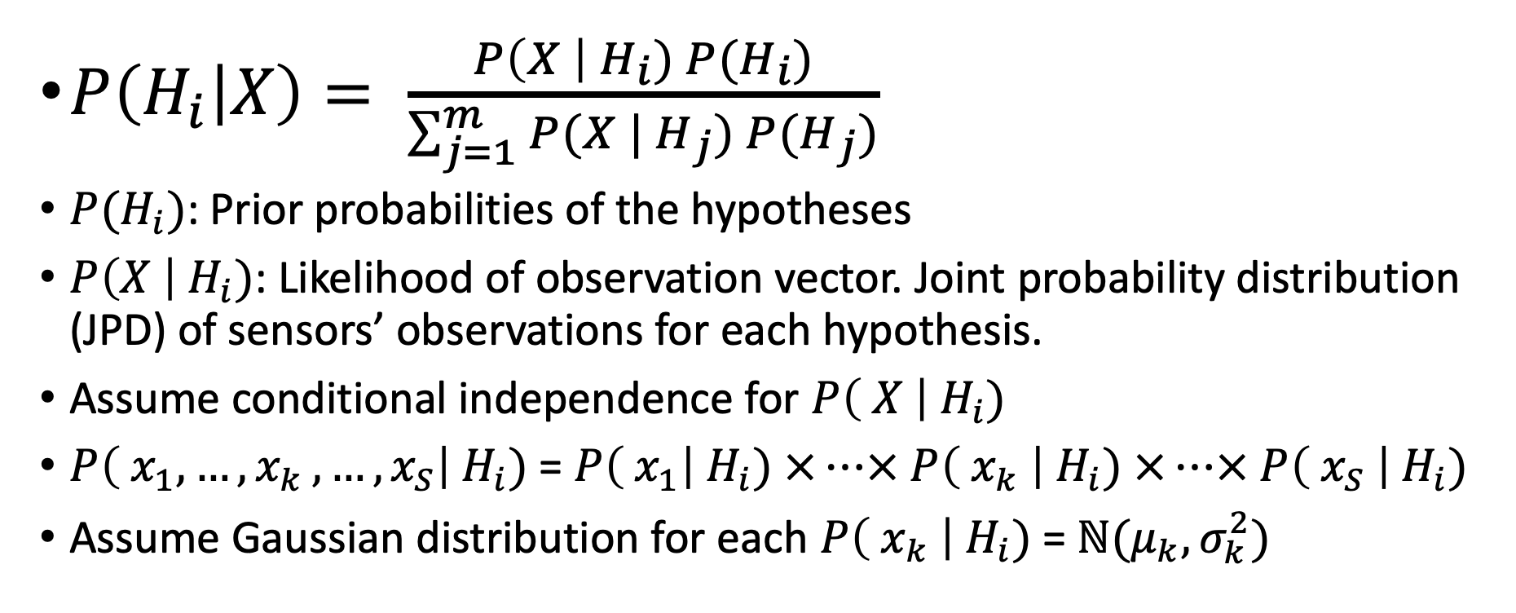
4.1 Methodology: Bayes Formula
$P\left(H_{i} | X\right)= \frac{P\left(X \right|{ H}_{i}) P(H_{i})}{\sum_{j=1}^{m}{P(X | H_{j})} P(H_{j})}$
$P(H_{i})$: Prior probabilities of the hypotheses
$P\left(X \right|{ H}_{i})$: Likelihood of observation vector. Joint probability distribution (JPD) of sensors’ observations for each hypothesis.
Assume conditional independence for $P\left( X \right|{ H}_{i})$
$P\left( x_{1},{…, x}_{k},…,x_{S}\right|{ H}_{i})$ = $P\left( x_{1}\right|{ H}_{i}) ×…× P\left( x_{k} \right|{ H}_{i}) ×…× P\left( x_{S} \right|{ H}_{i})$
Assume Gaussian distribution for each $P\left( x_{k} \right|{ H}_{i})$= $ℕ(μ_{k}, σ_{k}^{2})$

Slide 43
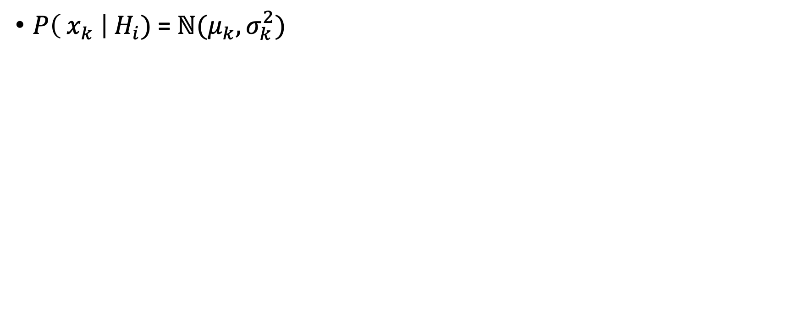
4.1 Methodology: Gaussian Distribution
$P\left( x_{k} \right|{ H}_{i})$= $ℕ(μ_{k}, σ_{k}^{2})$
Received Signal Strength
Sk
Notes:
Take a closer look at Gaussian Distribution...

Slide 44
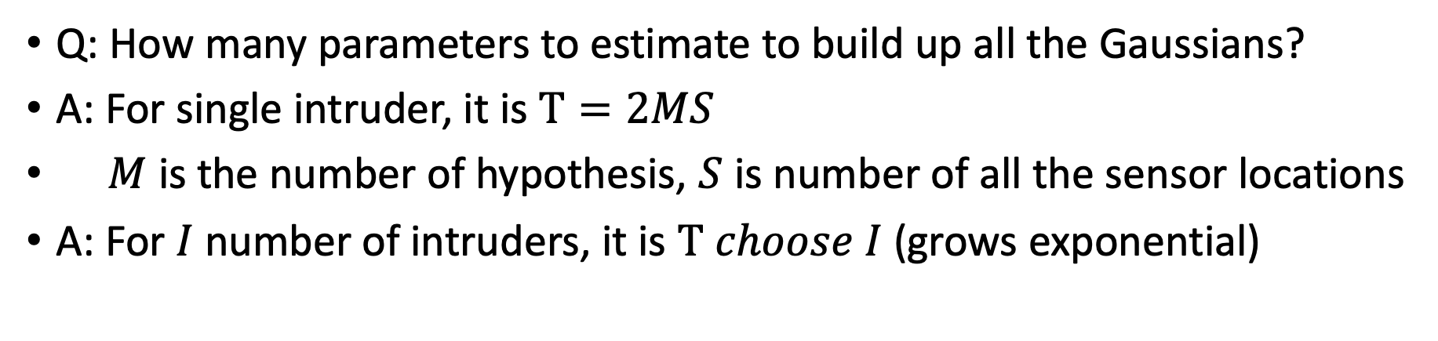
4.1 Methodology: # of Parameters?
Q: How many parameters to estimate to build up all the Gaussians?
A: For single intruder, it is $Τ=2MS$
$M$ is the number of hypothesis, $S$ is number of all the sensor locations
A: For $I$ number of intruders, it is $Τ choose I$ (grows exponential)
Exponential means infeasible to build up the all Gaussians, also infeasible for the Bayesian localization approach.

Slide 45
4.2 MAP* for MTL: Optimize computation time
The idea is to train only for a single intruder and use those single data to infer the multiple intruders in a divide-and-conquer manner.
Procedure 1: localize isolated intruders
Procedure 2: localize intruders situated close-by
Notes:
So, MAP* to the rescue

Slide 46
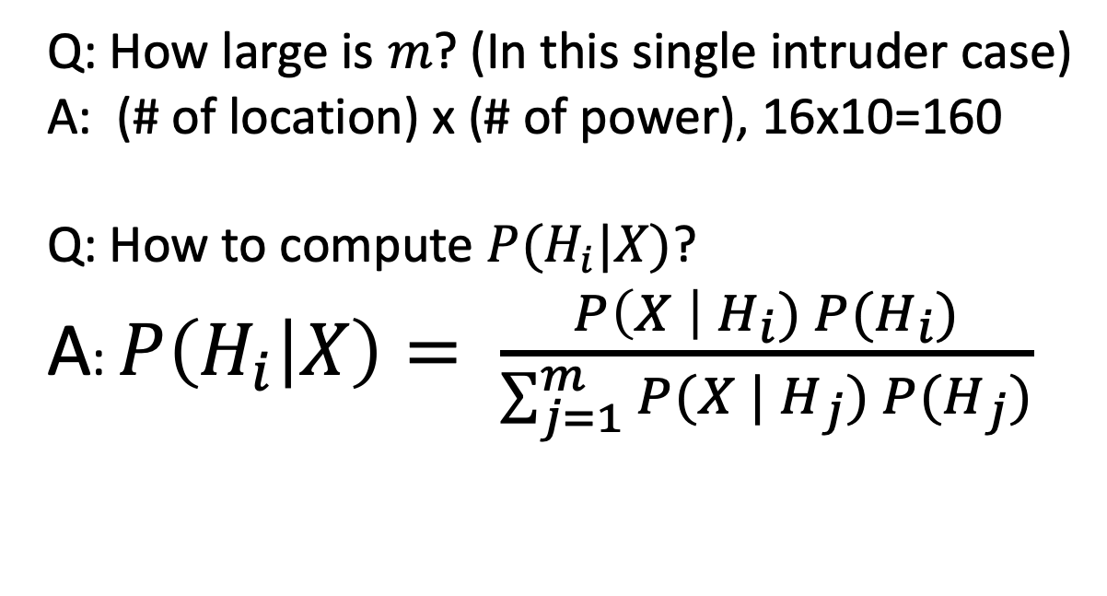
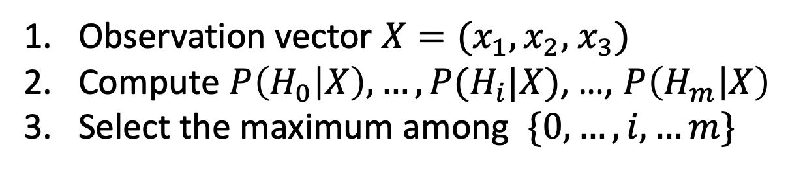
4.1 Methodology: Hypothesis-based Bayesian Approach (or MAP, or fingerprinting)
Observation vector $X=(x_{1},x_{2},$ $x_{3})$
Compute $P\left(H_{0} | X\right),…, P(H_{i}|X)$, …, $P\left(H_{m} | X\right)$
Select the maximum among $\{0, …, i, …m\}$
S1
Q: How large is $m$? (In this single intruder case)
A: (# of location) x (# of power), 16x10=160
Q: How to compute $P(H_{i}|X)$?
A: $P\left(H_{i} | X\right)= \frac{P\left(X \right|{ H}_{i}) P(H_{i})}{\sum_{j=1}^{m}{P(X | H_{j})} P(H_{j})}$
What is this?
S2
S3
Notes:
MAP is no more than three steps.

Slide 47
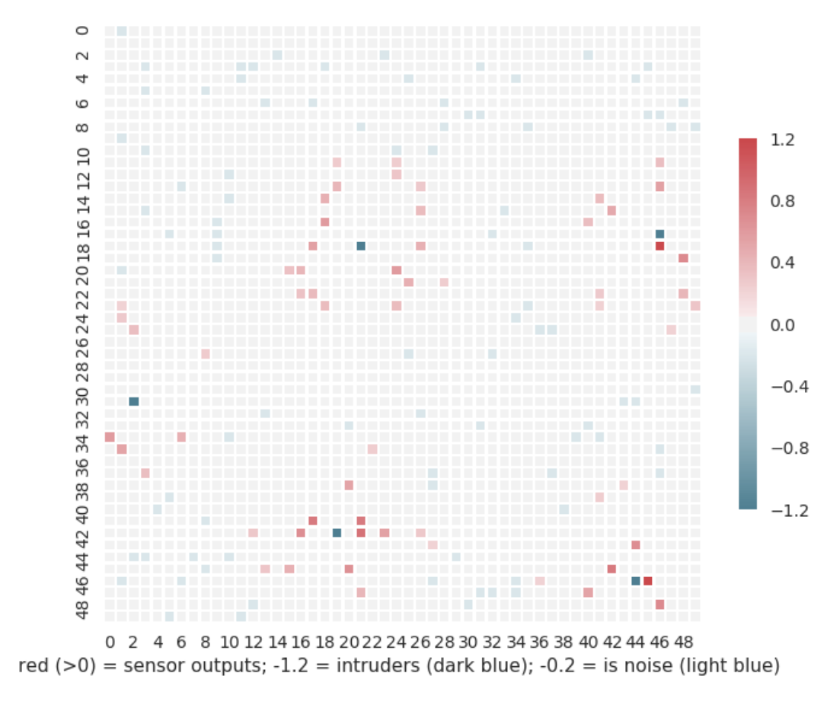
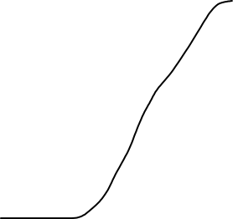
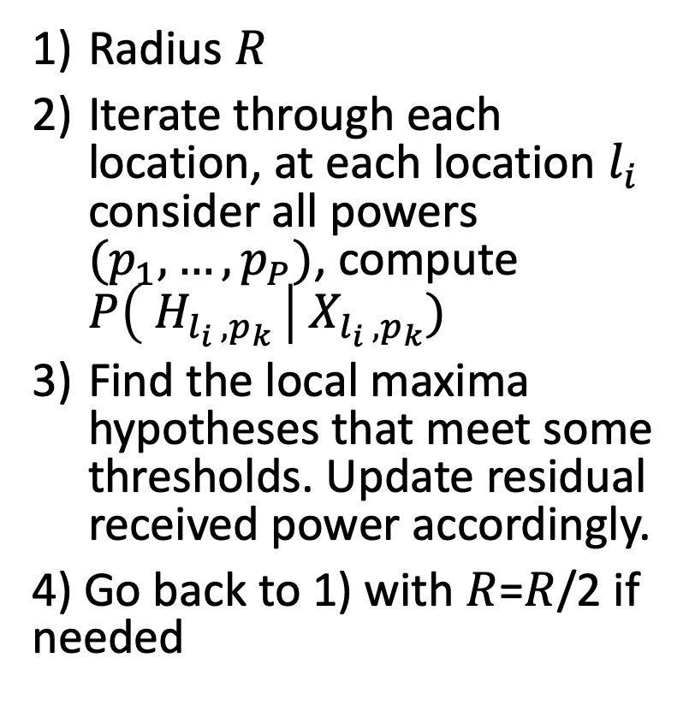


Procedure-1
Dark Blue: intruders. Red: Sensors with high RSSI
Light Blue: Sensors with low RSSI
Radius $R$
Iterate through each location, at each location $l_{i}$ consider all powers $(p_{1},…, p_{P})$, compute $P\left( H_{l_{i} , p_{k} }\right| X_{l_{i} , p_{k}})$
Find the local maxima hypotheses that meet some thresholds. Update residual received power accordingly.
4) Go back to 1) with $R$=$R$/2 if needed

Slide 48
Q: What will procedure-1 leave out?
A: Two or more intruders that are situated close-by.

Slide 49

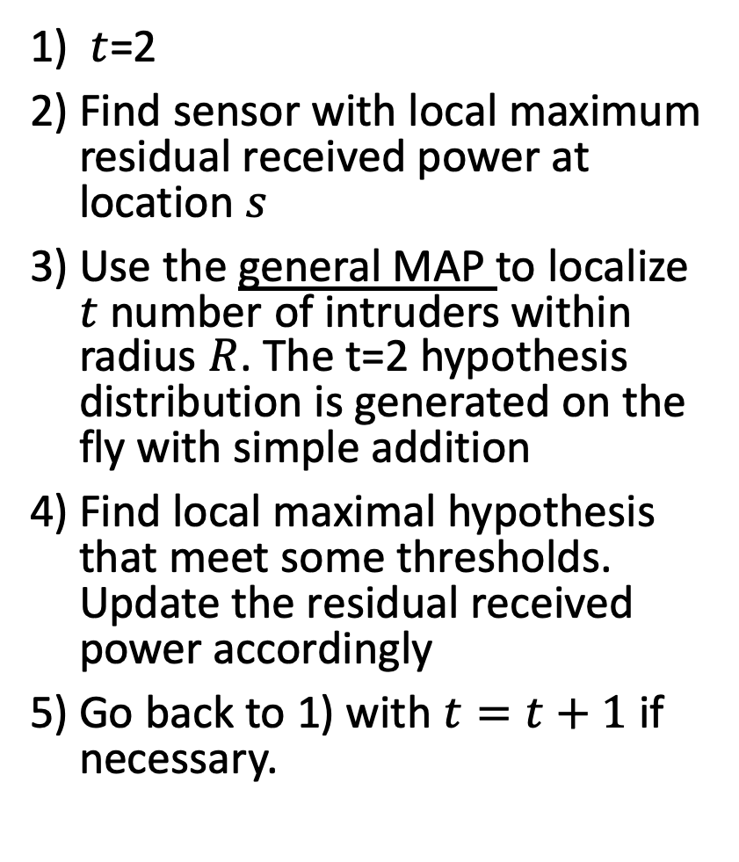
Procedure-2
Dark Blue: intruders. Red: Sensors with high RSSI
Light Blue: Sensors with low RSSI
$t$=2
Find sensor with local maximum residual received power at location $s$
Use the general MAP to localize $t$ number of intruders within radius $R$. The t=2 hypothesis distribution is generated on the fly with simple addition
Find local maximal hypothesis that meet some thresholds. Update the residual received power accordingly
Go back to 1) with $t=t+1$ if necessary.

Slide 50
Q: Solutions Other than Online Training?
A: Another method also seems feasible. Think of noise cancellation. We can deduct the received power of SUs from the observation vector, then do the MAP*.
Future work.

Slide 51
3.4 MAP** for MTL-SS
Now we include authorized users. TX = {authorized user, intruders}
Just more TX to localize, then remove the known authorized ones (Baseline)
Problem: the more TX to localize, the harder, localization performance likely to decrease
We alleviate this problem by doing online training and propose MAP**.

Slide 52
3.4 MAP**: Online Training
Primary Users (PU): assume static, but configurations may be unknown
Secondary Users (SU): assume dynamic, configurations are known.

Slide 53
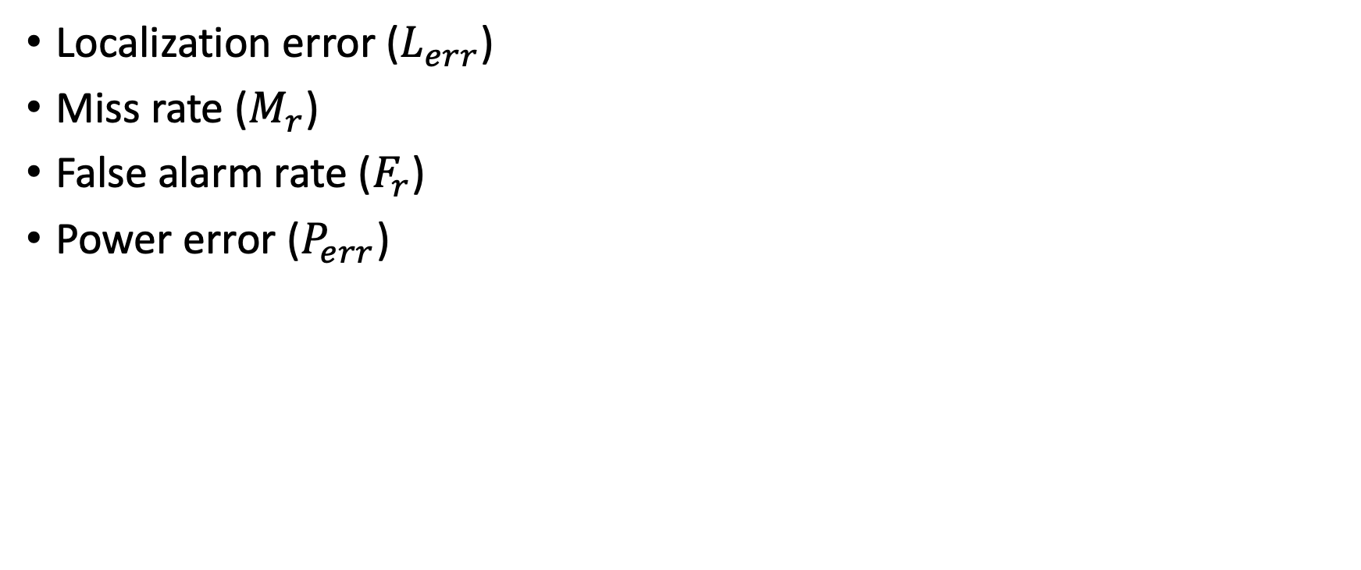
4.1 Evaluation Metrics
Localization error ($L_{err}$)
Miss rate ($M_{r}$)
False alarm rate ($F_{r}$)
Power error ($P_{err}$)

Slide 54
4.2 Algorithms Compared
SPLOT (Mobicom 2017)
Cluster (MILCOM 2006)

Slide 55
4.3 Large Scale Simulation
Using SPLAT! to produce training and testing data
An area of 4Km x 4Km in Long island, NY
Each cell is 0.1 Km x 0.1 Km. So 1600 discrete locations
1~10 TX, hundreds of sensors

Slide 56

4.2 Simulation: MTL -- Varying # of Intruders

Slide 57

5.3 Simulation: MTL -- Varying Sensor Density

